Slide 1
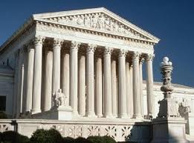
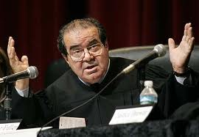
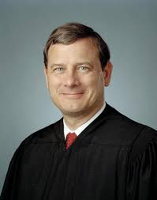
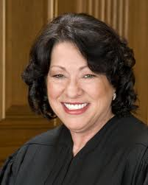
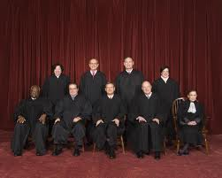
Article III The Judiciary

Slide 2
Section I
“The judicial Power of the United States, shall be vested in one supreme Court, and in such inferior Courts as the Congress may from time to time ordain and est
Congress establishes the number and role of the “inferior” courts
Does not specify how many judges must serve
Current law sets number at 9

Slide 3
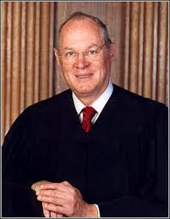
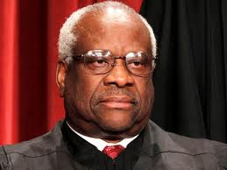
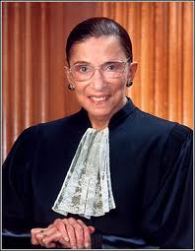
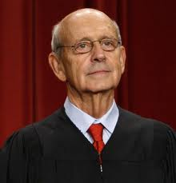
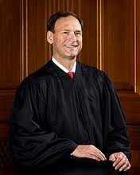
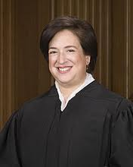
John Roberts
GW Bush
Antonin Scalia
Reagan
Anthony Kennedy
Reagan
Clarence Thomas
G. Bush
Ruth Bader Ginsburg
Clinton
Stephen Breyer
Clinton
Sam Alito
GW Bush
Sonia Sotomayor
Obama
Elena Kagan
Obama

Slide 4
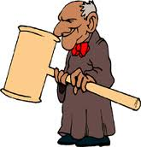
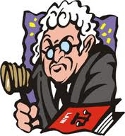
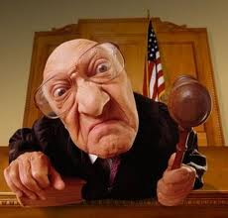
Section I
All federal judges hold their job for life and their salaries can not be reduced while they are serving
Removes judges from political process
Can only be removed via impeachment

Slide 5
Section I
Provides NO requirements to be a federal judge!!!
Most federal judges have met several criteria over the years
Lawyers or judges
Mostly white males

Slide 7
Section II – Powers of the Judiciary
The federal courts have the power to hear any cases that fall into the following categories:
Federal questions (Constitution or national laws)
Treaty violations
Cases involving ambassadors or public ministers
Anything occuring on waterways
Anytime the U.S. is a party in the case
Disagreements between states
Disagreements between citizens in different states or citizens of a state and a country

Slide 8
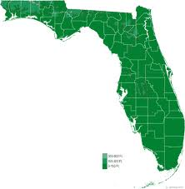
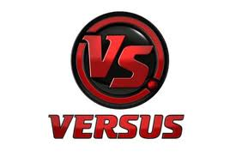
Section II – SC’s original jurisdiction
Supreme court mainly hears appeals cases
Has original jurisdiction in two circumstances:
Cases affecting ambassadors
Whenever a state is a party to a case

Slide 9
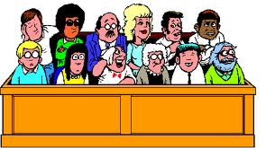
Section II
All trials, except impeachment, shall be by jury
Must be in state of commission

Slide 10
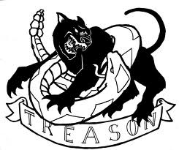
Section III
Defines treason
Treason against the United States, shall consist only in levying War against them, or in adhering to their Enemies, giving them Aid and Comfort.
No Person shall be convicted of Treason unless on the Testimony of two Witnesses to the same overt Act, or on Confession in open Court.
A conviction of treason MAY NOT harm a person’s family once they are dead

Slide 11
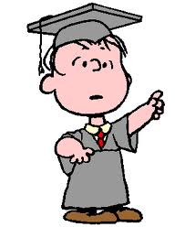
WHOA! Judicial REVIEW?????
WAIT! I thought the Supreme Court had some kind of checks and balances power on the other branches????

Slide 12
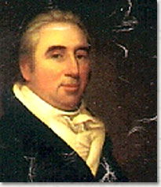
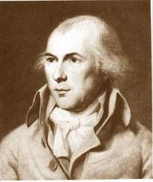
Judicial Review
NOT IN ARTICLE III!!!
NOT IN CONSTITUTION AT ALL!!!!
Arises from the case of Marbury vs. Madison (1803)

Slide 13
Marbury vs. Madison (1803)
Election of 1800 – Jefferson defeats Adams
In late Feb. – March 1801 Adams appoints several dozen judges (and they are approved by the senate)
Judges are issued an official commission which they must have to serve
March 5th, several commissions (including William Marbury’s) are not delivered.
Jefferson instructs his Secretary of State (James Madison) NOT to deliver the commissions
Marbury, understandably upset, petitions the Supreme Court for a writ of mandamus (which would require Madison to deliver the commissions)
Claimed he could do this because the Judiciary Act of 1789 allowed for direct petition of the Supreme Court

Slide 14
Marbury v. Madison (1803)
The Supreme Court considered 3 questions:
1. Did Marbury have the right to his writ of mandamus?
YES, everything was official
2. Could a court grant the writ?
YES, courts do it all the time in the form of subpoenas
3. Could the Supreme Court grant the writ?
NO!
The Constitution limits the original jurisdiction of the SC. The part of the Judiciary Act that expanded that was unconstitutional

Slide 15
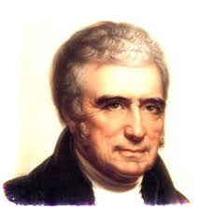
Marbury v. Madison (1803)
Chief Justice John Marshall creates “judicial review” in his opinion:
"It is emphatically the province and duty of the judicial department to say what the law is. Those who apply the rule to particular cases, must of necessity expound and interpret that rule. If two laws conflict with each other, the courts must decide on the operation of each." — Chief Justice John Marshall

