Slide 1
Electing Members of Congress “Apportionment & incumbency

Slide 2
House Apportionment
Census conducted every 10 years
Based on population, each state is awarded X number of representatives

Slide 3
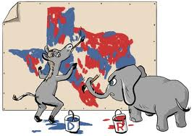
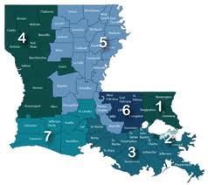
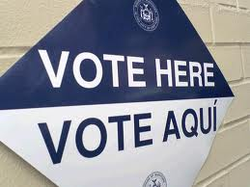
House Apportionment
State legislatures redistrict
Issues
Contiguity
Size of the district
Population important, not geographic size
Racial Equality
Voting Rights Act of 1965

Slide 4
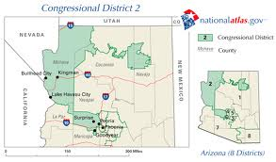
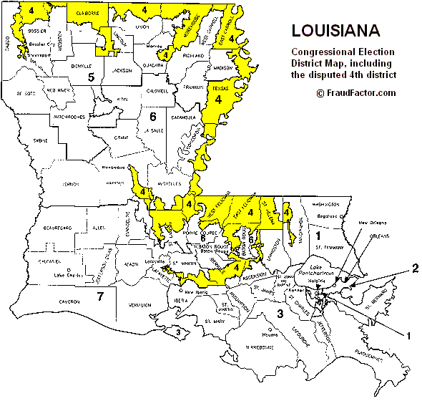
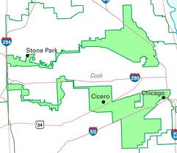
Contiguity
Districts are supposed to be contiguous for both ease of representation and to reduce corruption
Many “work-arounds” have developed

Slide 5
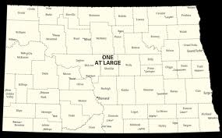
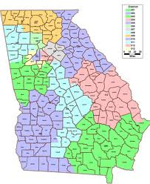
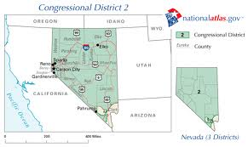
Size of the District
Malapportionment: having districts of unequal size
Favors voters in smaller districts
Focus on population not geographic size

Slide 6
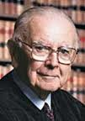
Size of the District
Supreme Court in Baker vs. Carr (1962)
Districts must be as equal as possible
“One man, one vote”
Most states allow up to a 10% spread
William Brennan
“One man, one vote”

Slide 7
Racial Equality
Districts must meet equality requirements of the Voting Rights Act of 1965
A minority group can not be “drawn out” of a district
This is called “cracking”
Minorities also cannot be drawn INTO a single district that only includes that group
This is called “packing”

Slide 8
Minority representation
Cracking
Packing
Notes:
Sadly, many techniques to deprive minorities of a meaningful vote.
At-large: Many districts with multiple seats were kept as “at-large” districts. In these districts, the majority vote would predictably beat the minority vote for every seat. In this district, there are 20 (say) white voters and 16 minority voters. And the majority will win every time.
Districts can improve the situation, but they don’t necessarily do so. One district-based technique is called “cracking”: split the minority community up so that its voting power is diluted. Here, each district has 5 white voters and 4 minority voters.
In “packing”, the objective is to cram as many minorities as possible into one district, to limit minority power to that one over-full district. Minorities are “bleached” from the surrounding areas, leaving the white voters firmly in control.

Slide 9
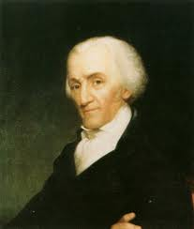
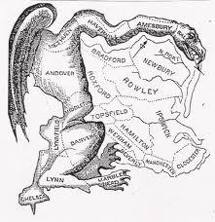
Racial Equality
Gerrymandering: drawing a congressional district in a way that clearly favors a particular party or candidate
Elbridge Gerry

Slide 10
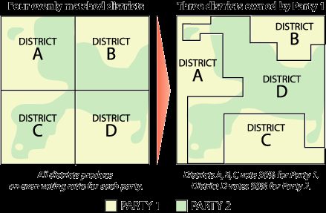

Slide 11
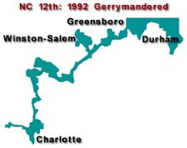
Racial Equality
Shaw vs. Reno (1993) dealt with NC 12th district
District was drawn to favor black voters
SC – Race MAY be used for districting purposes, but it must be under STRICT SCRUTINY

Slide 12
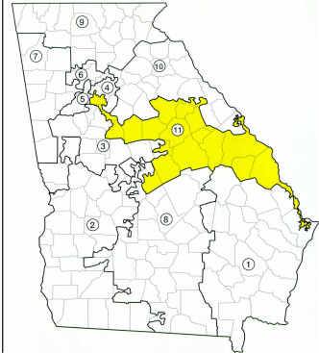
Racial Equality
In 1995 Georgia’s 11th district also was overturned by the Supreme Court for being racially gerrymandered

Slide 13
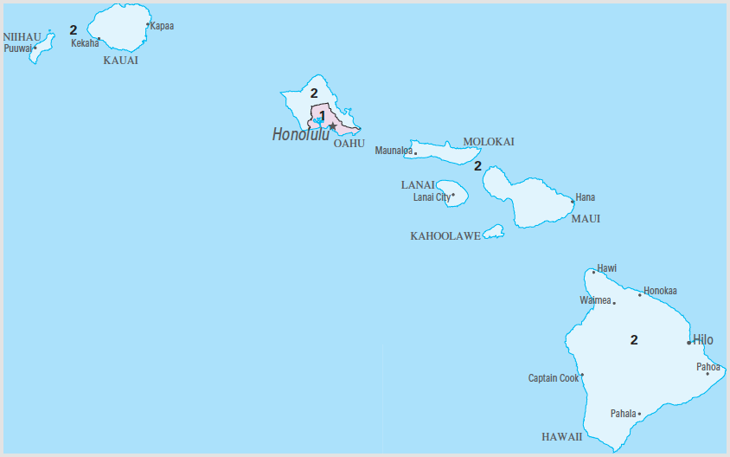
Racial Equality
Making districts based on race is not always bad
Majority-Minority districts
Districts where the majority of the people in the district are a racial or ethnic minority in the state
Are allowed IF race was not the “motivating” or “predominant factor”
Hawaii’s 1st district is the country’s only Asian Majority-Minority district

Slide 14
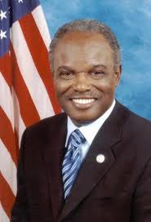
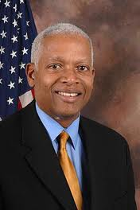
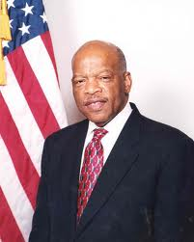
Racial Equality
In Georgia, David Scott, Hank Johnson, and John Lewis are all in majority-minority districts

Slide 15
Should States Do this?
Who else could draw lines?
Several states allow the state supreme court to draw the lines
Committee selected by legislature
Informed citizens
Sophisticated computer software
California and Arizona are moving away from having the state legislature do this
They have implemented “redistricting commissions”
In California, it is a 14 person commission that is a mixture of Republicans, Democrats, Independents, and at least 2 members of a third parties
Combination of appointments and applications

Slide 16
incumbents

Slide 17
Incumbents

Slide 18
Incumbents: why?
Money: they have it and people want to give it to them

Slide 19
Incumbents

Slide 20
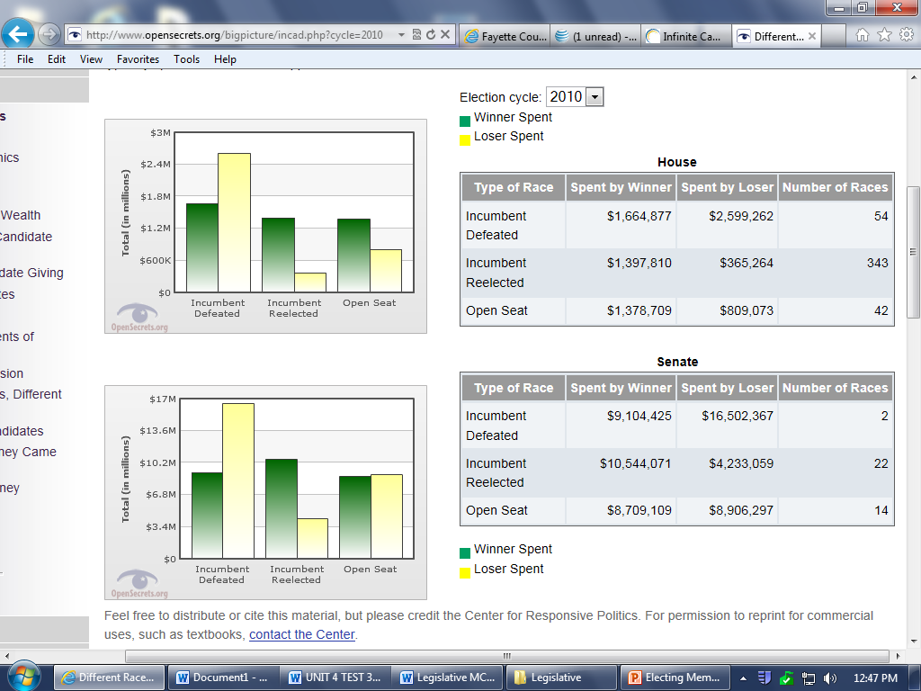

Slide 21
Incumbents and Pacs

Slide 22
Incumbents: why?
Money: they have it and people want to give it to them
Name Recognition
In one Gallup poll in 2010, 42% could name both senators and their member of congress. Only 12% could name their opponent in the race
Franking Privilege
Free mailing, not supposed to be used for campaign purposes
Greater access to media
Generally have more campaign experience
“Credit-Claiming”
Casework for constituents
Weak Opponents

Slide 23
Safe vs. marginal
Safe district
A congressional district where the incumbent is expected to win, usually by a large percentage
Marginal
A “toss-up” or district where there is a close race
If early polling is showing a margin of 5% or less is a good indicator

Slide 24
Term limits?
Pros
Cons
Voters prefer it
Favors merit over seniority
Increases Competition
Reduce special interest ties
Builds a “citizen” congress
Terminates “good” politicians along with “bad”
Term limits not the problem, set up of Congress is
Loss of knowledge and experience
Encourages “lame duckism”

