Slide 1
Federal Bureaucracy

Slide 2
What is it?
Bureaucracy A large organization in which people with specialized knowledge are organized into a clearly defined hierarchy of bureaus and offices, each of which has a specified mission.
Bureaucracy Public agencies that translate the intent of democratic institutions into action.

Slide 3
Why is it needed?
Ability to organize large tasks
Concentration of specialized talent

Slide 4
Who is it?
Most demographically representative part of government.
Diversity of jobs mirrors the private sector.

Slide 5
Who is it?
Spoils System (patronage) dominated the 19th and (most of the) 20th century bureaucracy.
Pendleton Act (1833)
Established civil service commission
This group writes tests/exams and creates requirements for promotion based on merit
Merit System: people hired & promoted on basis of qualifications & job performance, not political connections.
AKA Civil Service System

Slide 6
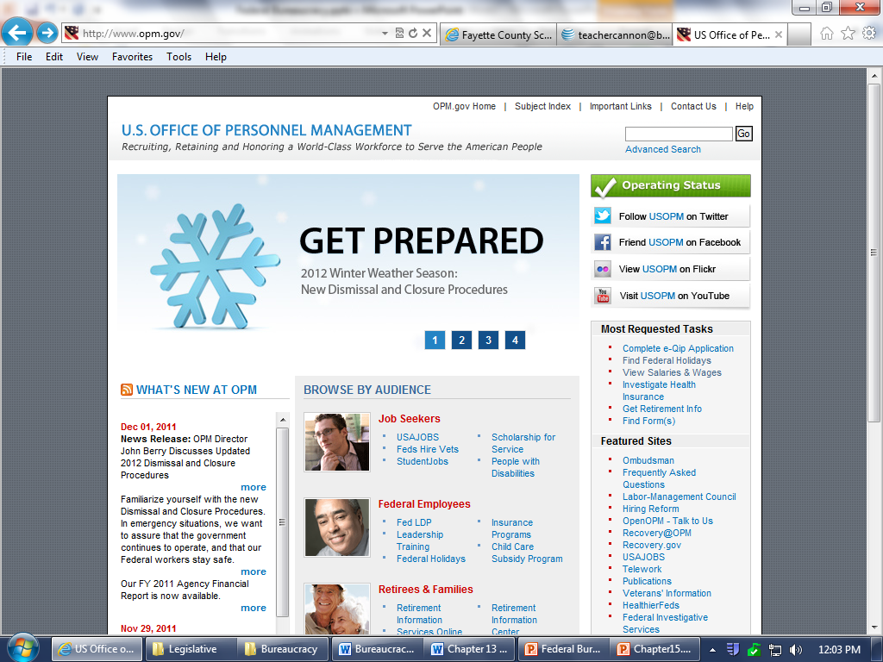
Who is it?
Office of Personnel Management (OPM) conducts most bureaucratic hiring

Slide 7
Who is it?
Other bureaucratic jobs
Schedule “C” jobs: jobs just below cabinet
Name-Request Jobs: job created for someone in particular based on a particular skill or ability
The Other Route to Federal Jobs: Recruiting from the Plum Book
Lists the very top jobs available for Presidential appointment.
Presidents work to find capable people to fill the positions.
Some plum jobs (ambassadorships) are patronage

Slide 8
Who is it?
15 Cabinet Level Departments

Slide 9
Who is it?
Also includes:
Independent Executive/Regulatory Agencies
CIA, EPA, FCC, FTC, Federal Reserve Bank
Heads of these are somewhat independent because they cannot be removed by the President
Government Corporations
Post Office, AMTRAK, NASA(?)
Other Government Entities
Library of Congress, Government Printing Office

Slide 10
What do Bureaucrats do?
Disburse Money/Services
US DOE Student Loans
USDA farm loans
Section 8 housing (HUD)
Veterans Affairs assisstance
Social Security
IRS Refunds
Small Business Administration Loans

Slide 11
What do Bureaucrats do?
Clarify laws through Rulemaking

Slide 12
What do Bureaucrats do?
Clarify Laws through Rulemaking
Georgia General Assembly passed a law requiring specific graduation requirements
Georgia Department of Education researches, writes, seeks public opinion for, and enacts the Georgia Graduation Rule (160-4-2)

Slide 13
What do Bureaucrats do?
Regulate Businesses
Similar to rulemaking but regards rules made to protect public health, safety, economic stability, etc
FDA and rules concerning chemicals in food/make-up etc
FDIC tells banks what kinds of activities they may engage in with customer’s money
Equal Employment Opportunity Commission’s enforcement of fair hiring practices

Slide 14
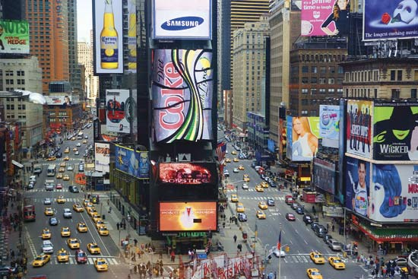
EPA sets pollution requirements
FCC censors what can and can be shown on ads
DOT Rule forces states to set 21 as drinking age to get $
Department of HUD gives economic incentives for “green” buildings
FDA Requires Coca Cola to list ingredients
NY Taxi & Limo Commission sets license requirements
Food vendors have to pass national and state health codes

Slide 15
Trends in Bureaucracy
Large growth in scope and physical size since 1930’s
New Deal programs
Public support for increased government
1970’s “Golden Age” of rulemaking
Increased environmental concerns
Nixon/Congress struggles
Ford/Carter weak executives

Slide 16
Who controls Bureaucracy?
Dual control
Congress controls budget
President controls appointments and agenda (to some degree)
Interest Groups also use resources lobbying for favorable legislation

Slide 18
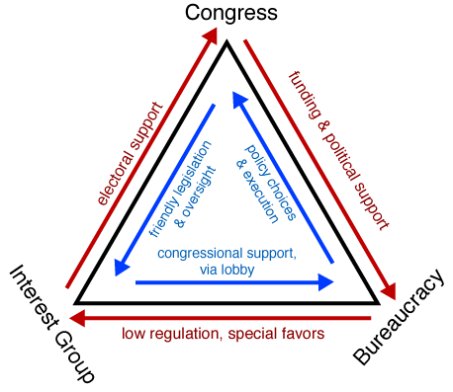
Iron Triangles

Slide 19
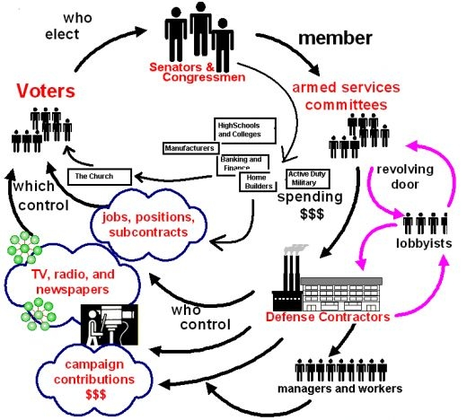
Issue Network
Similar to iron triangle, but also includes think tanks, press, voters, etc

