Slide 1
“The Lighter Side of Educational Research”
Chris Cannon
Sandy Creek High School

Slide 2

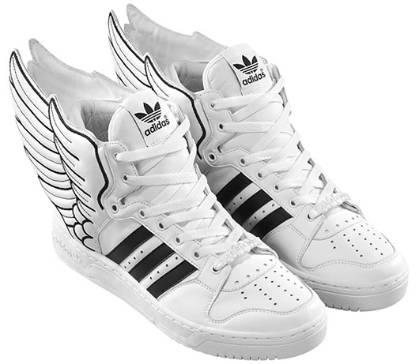

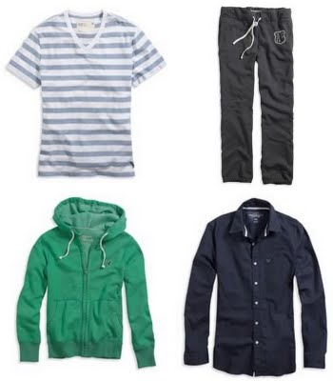
Back to school…in style!
7.2 billion spent on back to school clothes
2.8 billion on educational materials
  US Dept. of Education

Slide 3


Does education matter?
$83,144w/ advanced degree
$58,613 w/ Bachelor’s Degree
$31,283 w/ high school diploma
$21,023 w/ less than a high school diploma
  U.S. Census Bureau

Slide 4
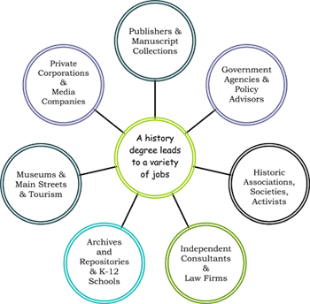

Best / Worst Field
Petroleum Engineering
  Avg. Starting salary
    $75,621
Social Sciences
  Avg. Starting Salary
    $38,920
      US Census Bureau

Slide 5

Facebook?
High Schoolers who log in once a day are more likely to:
  Buy cigarettes
  Seek sellers of marijuna
  Be more politically active
  Try more types of alcohol
  Stay in college longer
    Various studies: Pew Center, University of Wisconsin, Journal of College Retention

Slide 6
Funny = Learning
Garner's (2006) Participants viewed three video-recorded lectures on statistics and research methods. Each participant was randomly assigned to one of two conditions.
In the “humor condition”, participants viewed lectures with humorous examples. The other participants viewed the lectures without the humor segment (control condition).
The participants in the humor condition recalled more information on average than participants in the control condition.
  Garner, R. L. (2006). Humor in pedagogy: How ha-ha can lead to aha! College Teaching, 54, 177-180.

Slide 7
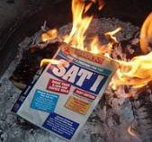

Bad day on the SAT?
“I didn’t do my best because I was having a “bad day””
Students who claimed to have a “bad day” on their initial SAT performance had statistically the same increase on re-takes as other students who claimed they studied and “did their best”
Students who admitted they didn’t study or took some other form of personal responsibility improved by larger margins
  Educational Testing Service

Slide 8

Treating Girls Differently
Sadker “Sexism in the Classroom”
    (original studies in 80’s, being redone)
  Teachers more likely to
    call on boys, even if girls put their hands up first
    give boys more wait time than girls
    Make more eye contact with boys
    Give boys more specific feedback on assignments

Slide 9
Having money makes you smart?
Children with higher SES backgrounds were more likely to be proficient on tasks of addition, subtraction, ordinal sequencing, and math word problems than children with lower SES backgrounds
  (Coley, 2002).
In a nationwide study of American kindergarten children, 36% of parents in the lowest-income quintile read to their children on a daily basis, compared with 62% of parents from the highest-income quintile
  (Coley, 2002).
Children’s initial reading competence is correlated with the home literacy environment, number of books owned, and parent distress
  (Aikens & Barbarin, 2008).
Children from low-SES environments acquire language skills more slowly, exhibit delayed letter recognition and phonological awareness, and are at risk for reading difficulties
  (Aikens & Barbarin, 2008).
Of high school math teachers in low income school districts 27% majored in mathematics in college as compared to 43% of teachers who did so in more affluent school districts.
  (Gimbert, Bol, & Wallace, 2007)
Students from low-SES schools entered high school 3.3 grade levels behind students from higher SES schools. In addition, students from the low-SES groups learned less over 4 years than children from higher SES groups, graduating 4.3 grade levels behind those of higher SES groups
  (Palardy, 2008).

Slide 10
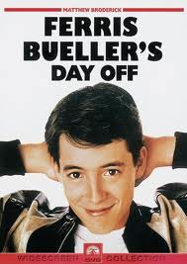
Does attendance matter?
General correlation
Certain days more important
Mandatory attendance policies not as effective
Selective attendance policies more effective
  Chen study: General attendance had 5.1% improvement on exam score
  Narrowed down to specific days had 18% improvement on exam score
  Review days, activity days, introduction of new unit most important
Allen, D. O., & Webber, D. J. (2010). Attendance and exam performance at y: a case study. Research in Post-Compulsory Education, 15(1), 33-47.
Chen, J., & Lin, T. (2008). Class Attendance and Exam Performance: A Randomized Experiment. Journal of Economic Education, 39(3), 213-227.

Slide 11
What makes a “good” teacher
Students rated teachers in 9 categories and in 4 descriptors of those categories
  (eg., friendly discipline, competent discipline, interesting discipline, composite discipliine)
Strongest correlations to getting a “good teacher” rating:
  Competent discipline
  Friendly interaction with students
    Babad, Elisha; Avni-Babad, Dinah; Rosenthal, Robert Journal of Educational Psychology, Vol 95(3), Sep 2003, 553-562.

Slide 12
Cheating as instructional tool?
Cheating in virtual worlds: transgressive designs for learning
  Students who created “cheat” sites for www.whyville.com were more engaged in science classes
  More motivated to learn science concepts to apply to the cheat sites
  One teacher used it as an educational tool
    Had students create “cheat sites” using content from class
    Student test scores improved
Kafai, Y. B., & Fields, D. A. (2009). Cheating in virtual worlds: Transgressive designs for learning. On the Horizon, 17(1), 12-12-20. doi:10.1108/10748120910936117

Slide 13
Don’t OBFUSCATE
Students who purposefully used more complex on college entrance essays less likely to be chosen!
*1,300 entrance applications to Stanford University

Slide 14
School Uniforms
Gossman, J. (2011). Research examines school uniforms' impact on education. Education Daily, 44(150), 3.
Meta-analysis from National Bureau of Educational Research
  NO statistically significant impact on grades
  Minor impact on discipline
  NO statistically significant impact on standardized tests

Slide 15
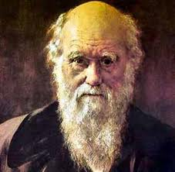


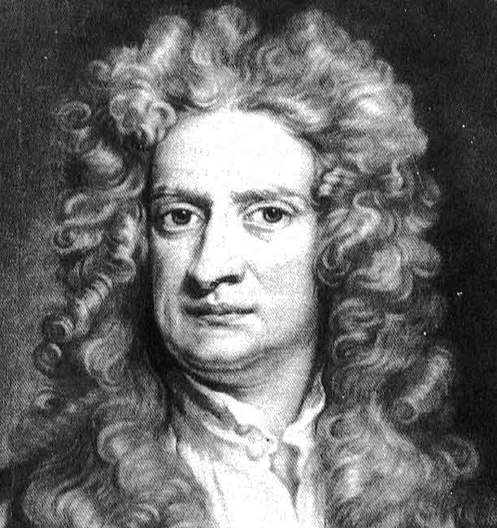
Confused on the Purpose?
Official policy of the Kansas State Board of Education:
“While individual school systems are allowed to teach both Creationism and Evolution, children should not believe in Darwin's theory of evolution any more than they believe in Newton's theory of gravitation, Faraday's and Maxwell's theory of electromagnetism, or Pasteur's theory that germs cause disease.” (1999)

Slide 16

High School Students need MORE sleep?
Teenagers may require as much as 9 hours in some cases to maximize brain activity
Schools that start school later in the day report fewer problems with tardies and sleeping in class
  Feinberg School of Medicine and the Center for Sleep and Circadian Biology at Northwestern University (2005, re-confirmed 2009, in publication)

Slide 17
E-Books?
University of Washington (2009)
  Students did not like in-flexibility of e-readers (Kindle)
  Found it hard to break old habits of writing on pages, “dog-earing” pages, etc
University of California (2011)
  Students using ONLY e-readers had a more difficult time retaining information
  At the end of the study, 44% preferred printed books, 35% preferred e-books
  E-books preferred for “short research” situations

Slide 18
Why to study vs. What to study
Learning orientation vs. Performance Orientation
Highest achieving students in over 100 schools discussed the importance of learning more than grades
Teachers who focused primarily on performance:
  produced poorer scores and had other negative consequences (Elementary students performing unrelated tasks)
    Watkins, Chris. (2009). Learning, Performance, and Improvement. Research Matters. 35:2. 44-56.

Slide 19
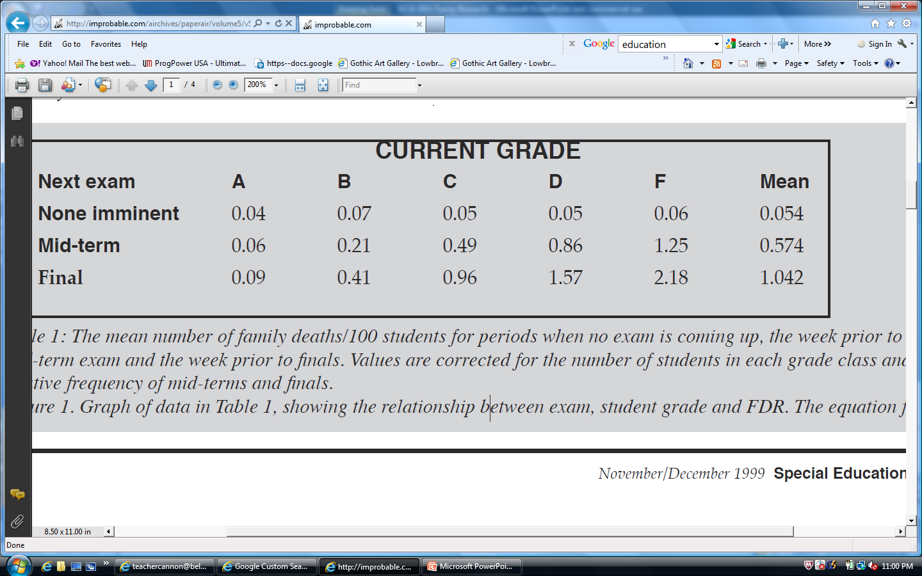
Graveyard Grannies
Adams, Mike. Dead Grandmother/Exam Syndrome. Annals of Improbable Research. Nov/Dec. 1999.

Slide 20
Bending History?
“Dinosaurs… every child seems to go through a stage of loving them! We’ve made our Dinosaurs Learn ‘N Folder [sic] to take advantage of this love. Your child will learn about these creatures, how they ate, where they lived, how we have come to know about them, and much more. There is no reference to dates so you are free to insert your family’s personal view of the age of the earth and when dinosaurs roamed it.”
  Found on a “Live and Learn Press” packet in 2010

Slide 21
Contact info
THANK YOU THANK YOU THANK YOU!
Presentation available at
www.teachercannon.com
chris@georgiatestpractice.com
or
Cannon.chris@mail.fcboe.org

