Slide 1
Lobbying Basics

Slide 2
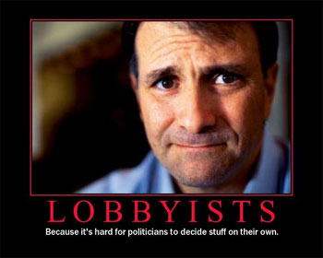
What is Lobbying?
Actions taken to influence or persuade an elected official to take a particular action

Slide 3
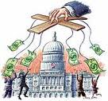
How is it done?
Money
Campaign donations
Fundraisers
Special events

Slide 5
How is it done?
Money
Campaign donations
Fundraisers
Special events
Information
Meetings with MCs
Literature
Advertisements

Slide 6
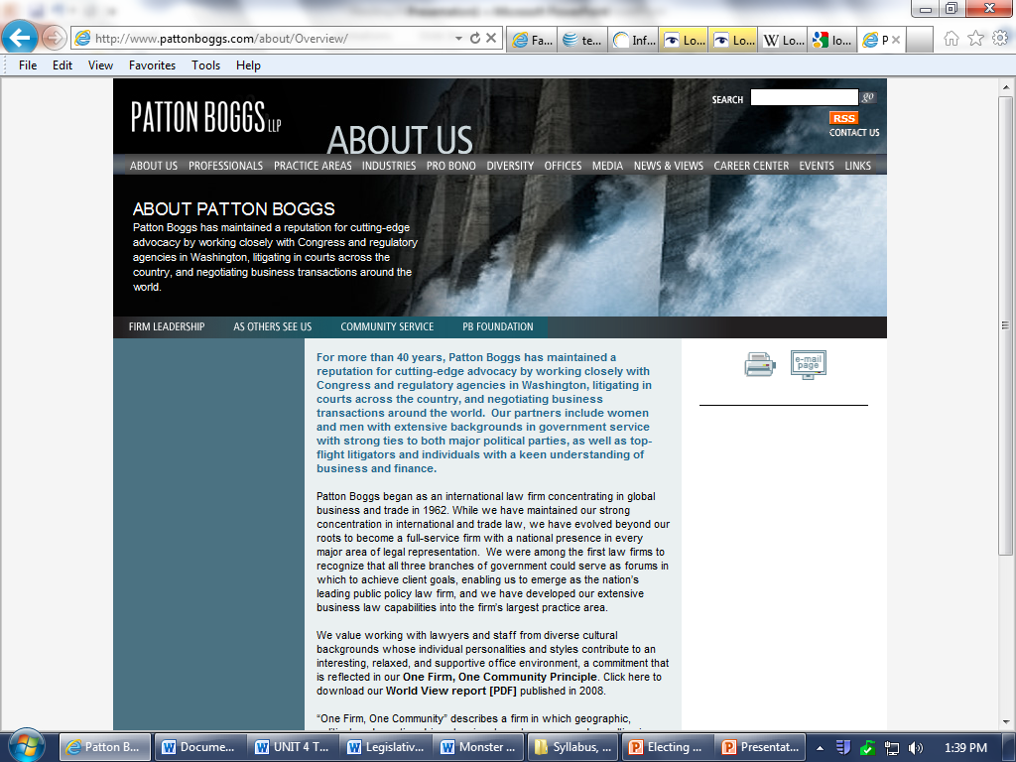
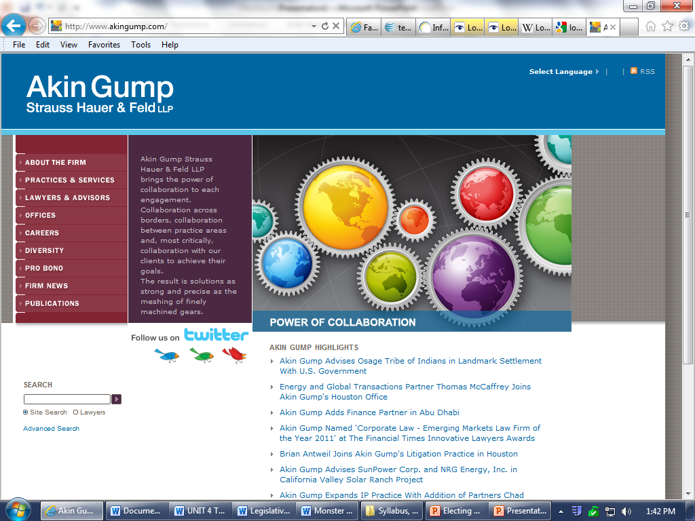
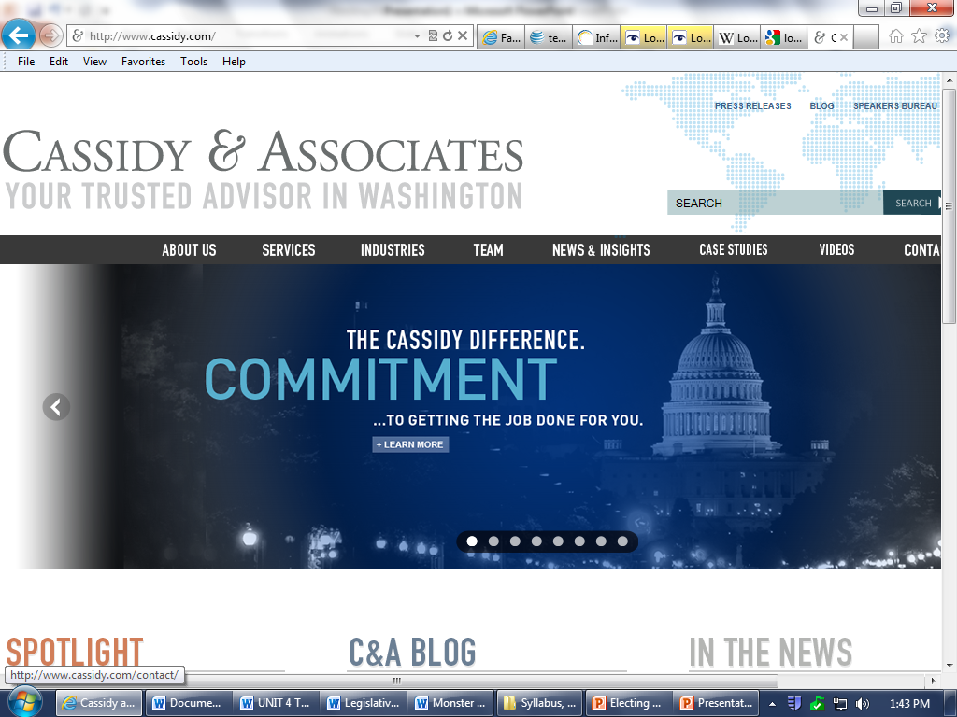
Who does it?
Lawyers, mainly, do the ACTUAL lobbying
Top lobbying firms:
Patton Boggs, Akin & Gump, Cassidy and Associates, etc

Slide 7
Who pays for the lobbying?
MOST major corporations and interest groups in the US
Companies that pay Patton Boggs:

Slide 8
Are they regulated?
Yes
Lobbying Disclosure Act (2008)
Anyone wishing to engage in lobbying activity MUST register with the Federal Government
Lobbying activity has a VERY broad definition including planning, strategizing, collecting money at the door of an event, etc
Every three months ALL activity (mailings, financial, etc) MUST be disclosed to at least 3 different agencies
Must list ALL clients and the amounts they spend
Congressman prohibited from accepting gifts from registered lobbyists
Does not apply to campaign funds

Slide 9
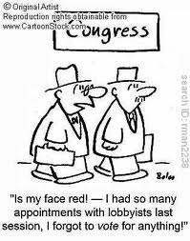
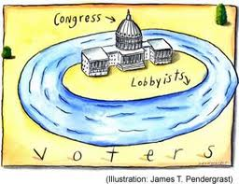
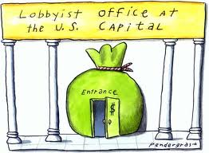
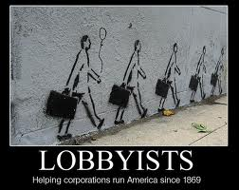
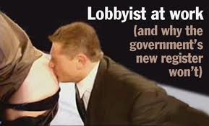
Is it bad?
Has a negative public connotation

Slide 10
Is it bad?
Has a negative connotation
Allowed (encoruaged?) by the first amendment
Right to “petition” the government
As with any good vs. bad, it depends on the side you’re on
Tobacco vs. Public Health Organizations
Environment vs. Oil drillers
Guns vs. Victims of Shootins
Abortion vs. Pro-Choice
Bottom line: Lobbyists CAN and DO provide much sought after information. Methodologies may be in question

