Slide 1
Performance Task
By: Tiffany Wynn

Slide 2
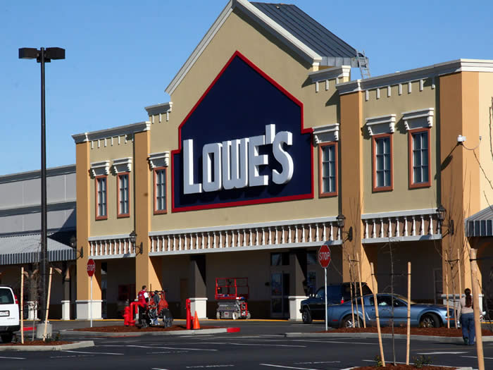
Part 1
Description of Lowes and CEO…..

Slide 3
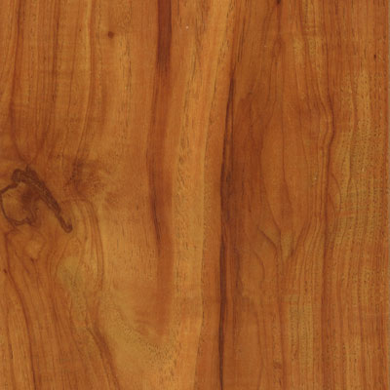
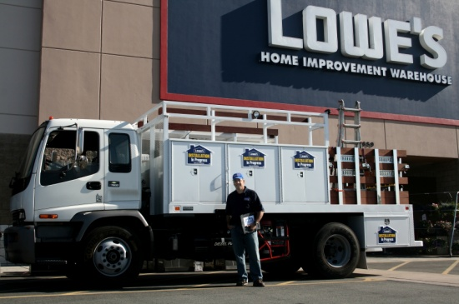
Examples
Land | Labor | Capital
Wood | Employees | Cash Registers
Cement on floor | Truck driver | Packaging machine
Aluminum | People who cut key/blinds etc | Cutting boards
Plastic |  | Bag rack

Slide 4
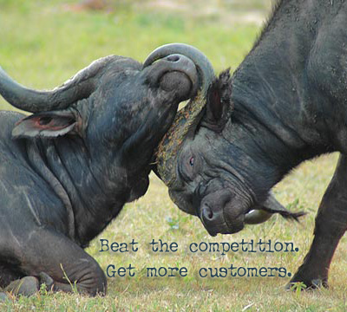
Competition and Comparative Advantage
Lowes has comparative advantage in selling items for home repair and home improvement compared to stores like Wal-Mart or Target. They sell more of these goods at better quality.
Even though they are the 2nd leading home-improvement store, Lowe’s is more DIY focuses. As far as Home Depot, the leading home-improve store, they have more commercial/contractor items.

Slide 5
LOWES PPC
This Production Possibilities Curve represents tradeoff Lowes must make between carpet and lumber. The more space they dedicate to carpet, the less they have for lumber.
Lumber
Y units
A
B
0
Carpet
X units
A shift from point A to point B would mean more space for carpet, but the opportunity cost would be…
Notes:
5

Slide 6
What is Scarce in Lowe’s???
#1: TIME!!!!!!!!!!!!!!!!!!!!!!!
(explanation)

Slide 7
What else is Scare????
#2: Item 2
Explanation

Slide 8
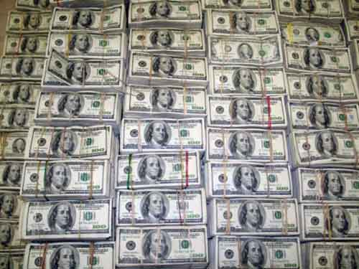
What else???
#3: Item 3
Explanation

Slide 9
Training
The Contact Center Training/Quality Assurance Coach conducts regularly scheduled monitoring sessions to evaluate agent performance and provide follow-up training to address weaknesses. The Contact Center Training/Quality Assurance Coach conducts ongoing group training sessions for new hires and existing employees, and serves as a coaching/performance management resource for operational program supervisors.

Slide 10
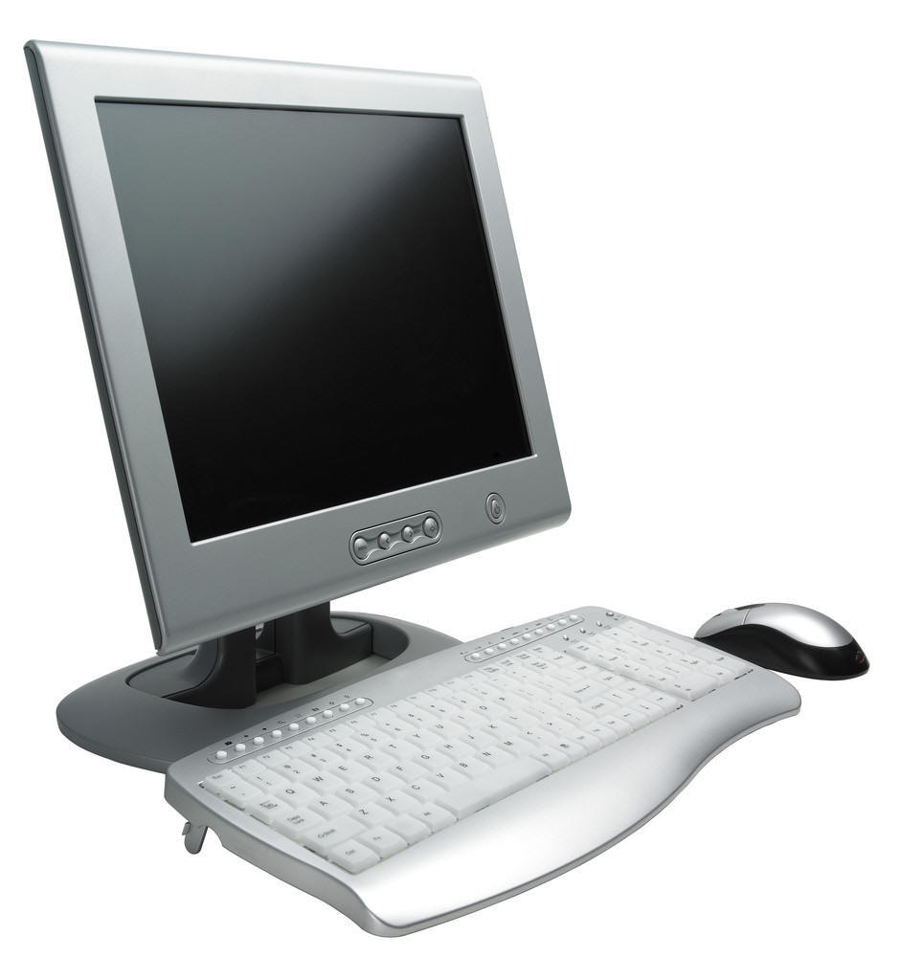
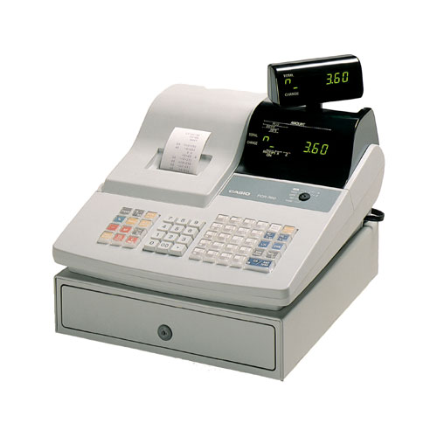
Technology
Computers
Cutting Machines
In store motor vehicles
Cash registers

